Slide 1

Database Connectivity
Presented By:
Elizer Ponio Jr. Department of Computer Science
College of Computing and Information Technologies

Slide 2
Outline
Database Connectivity
Three Layer Architecture
Database Connectivity Interfaces
Java Database Connectivity (JDBC)
Database Internet Connectivity

Slide 3
Database Connectivity
Database connectivity refers to the mechanisms through which application programs connect and communicate with data repositories.
Databases store data in persistent storage structures so it can be retrieved at a later time for processing.
The database management system (DBMS) functions as an intermediary between the data (stored in the database) and the end-user’s applications.

Slide 4
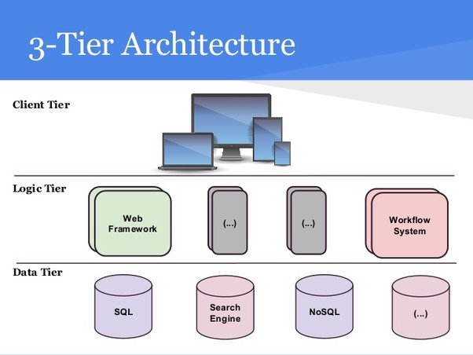
Three-tier Architecture
To better understand database connectivity software, we use client/server concepts in which an application is broken down in interconnected functional layers.
In the case of database connectivity software, you could break down its basic functionality into three broad layers:
Presentation/Client tier
Application/Logic tier
Data tier

Slide 5
Presentation Tier
The presentation tier is the user interface and communication layer of the application, where the end user interacts with the application.
Its main purpose is to display information to and collect information from the user.
This top-level tier can run on a web browser, as desktop application, or a graphical user interface (GUI).

Slide 6
Application Tier
The application tier, also known as the logic tier or middle tier, is the heart of the application.
In this tier, information collected in the presentation tier is processed sometimes against other information in the data tier using business logic, a specific set of business rules. The application tier can also add, delete or modify data in the data tier.
The application tier is typically developed using Python, Java, Perl, PHP or Ruby, and communicates with the data tier using API calls.

Slide 7
Data Tier
The data tier, sometimes called database tier, data access tier or back-end, is where the information processed by the application is stored and managed.
This can be a relational database management system such as PostgreSQL, MySQL, MariaDB, Oracle, DB2, Informix or Microsoft SQL Server, or in a NoSQL Database server such as Cassandra, CouchDB or MongoDB.
In a three-tier application, all communication goes through the application tier. The presentation tier and the data tier cannot communicate directly with one another.

Slide 8
Database Connectivity Interfaces
Just as SQL has become the de facto data manipulation language, a standard database connectivity interface is necessary for enabling applications to connect to data repositories. Below are popular interfaces for database connectivity.
Native SQL connectivity (vendor provided)
Microsoft’s Open Database Connectivity (ODBC), Data Access Objects (DAO), and Remote Data Objects (RDO)
Microsoft’s Object Linking and Embedding for Database (OLE-DB)
Microsoft’s ActiveX Data Objects (ADO.NET)
Oracle’s Java Database Connectivity (JDBC)

Slide 9
Java Database Connectivity (JDBC)
JDBC is an application programming interface (API) that allows a Java program to interact with a wide range of data sources, including relational databases, tabular data sources, spreadsheets, and text files.
JDBC allows a Java program to establish a connection with a data source, prepare and send the SQL code to the database server, and process the result set.
A JDBC API accesses data from the relational database tables. The data in these databases can be saved, updated, deleted and retrieved. JDBC uses drivers to connect with the database.

Slide 10
What is API?
Before jumping into JDBC Drivers, let us know more about API.
API stands for Application Programming Interface.
It is essentially a set of rules and protocols which transfers data between different software applications and allow different software applications to communicate with each other.
Through an API one application can request information or perform a function from another application without having direct access to it’s underlying code or the application data.
JDBC API uses JDBC Drivers to connect with the database.

Slide 11
JDBC Architecture
Java Application
JDBC API
JDBC Driver Manager
MySQL
Oracle
Data Source

Slide 12
JDBC Architecture
Application: It is a java applet or a servlet that communicates with a data source.
The JDBC API: The JDBC API allows Java programs to execute SQL statements and retrieve results.
DriverManager: It uses some database-specific drivers to effectively connect enterprise applications to databases.
JDBC drivers: To communicate with a data source through JDBC, you need a JDBC driver that intelligently communicates with the respective data source.
Java Application
JDBC API
JDBC Driver Manager
MySQL
Oracle
Data Source

Slide 13

Database Internet Connectivity
Millions of people all over the world access the Internet and connect to databases via web browsers or data services.
For example, they can use a smartphone app to get weather forecasts, stock prices, driving directions, concert tickets, or music downloads.

Slide 14
Database Internet Connectivity
Internet database connectivity opens the door to new, innovative services that do the following:
Permit rapid responses to competitive pressures by bringing new services and products to market quickly.
Increase customer satisfaction through the creation of innovative data services such as mapping data combined with GPS (Global Positioning System) information to provide location aware services. These applications present end users with information or services located near the users’ current location.
Allow anywhere, anytime data access using mobile smart devices via the Internet.
Yield fast and effective information dissemination through universal access from across the street or across the globe.

Slide 15
Web Server
In general, the web server is the main hub through which all Internet services are accessed.
For example, when an end user uses a web browser to dynamically query a database, the client browser requests a webpage from the web server.
When the web server receives the page request, it looks for the page on the hard disk; when it finds the page, the server sends it back to the client.

Slide 16
Web-to-Database Middleware
A server-side extension is a program that interacts directly with the web server to handle specific types of requests.
The server- side extension program retrieves the data from databases and passes the retrieved data to the web server, which in turn sends the data to the client’s browser for display.
The server-side extension makes it possible to retrieve and present the query results, but more importantly, it provides its services to the web server in a way that is totally transpar- ent to the client browser.
In short, the server-side extension adds significant functionality to the web server, and therefore to the Internet.

Slide 17
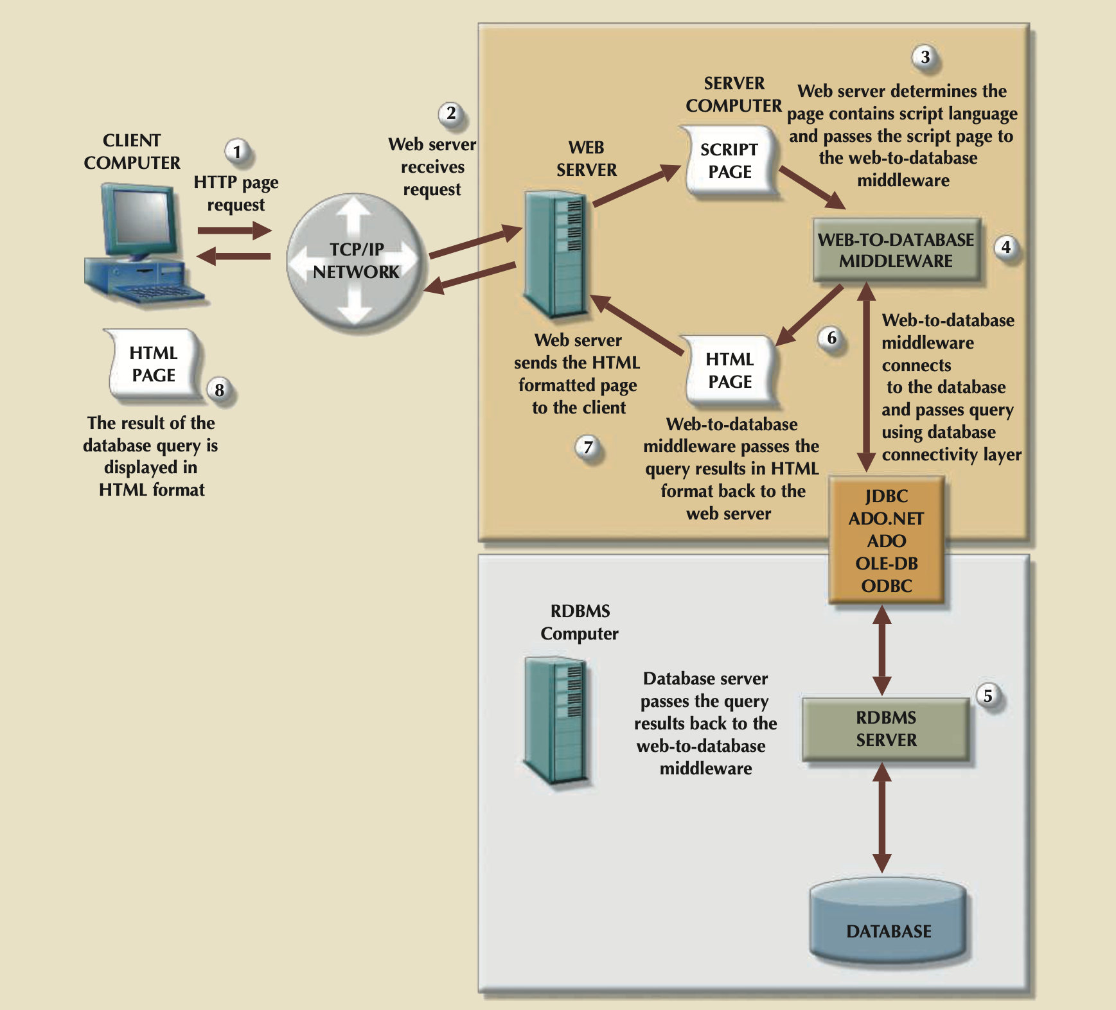

Slide 18
Web Server Interfaces
A web server interface defines a standard way to exchange messages with external programs. Currently, there are two well-defined web server interfaces:
Common Gateway Interface (CGI)
uses script files that perform specific functions based on the client’s parameters that are passed to the web server.
Application programming interface (API)
Is a newer web server interface standard that is more efficient and faster than a CGI script. APIs are more efficient because they are implemented as shared code or as dynamic-link libraries (DLLs).

Slide 19
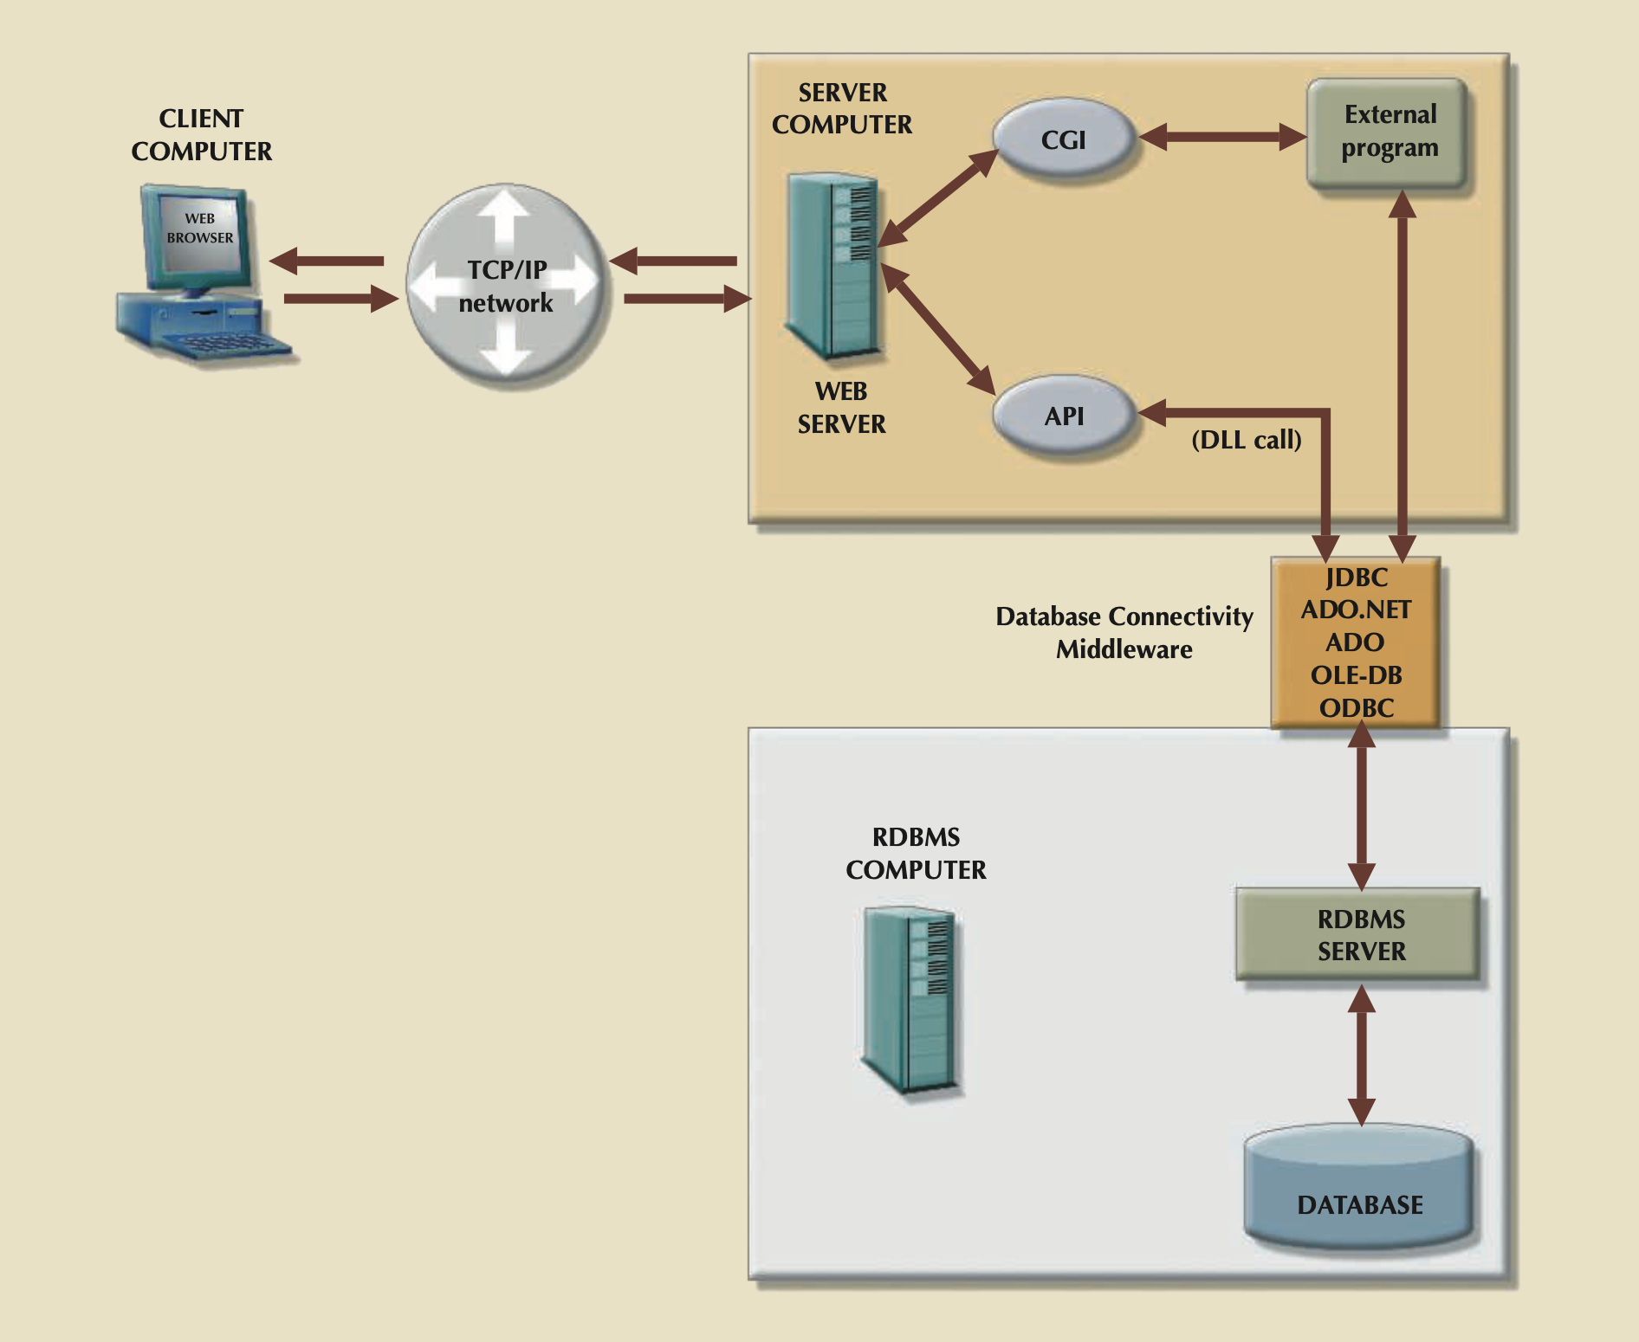

Slide 20



Web Browsers
The web browser is software such as Microsoft Internet Explorer, Google Chrome, Apple Safari, or Mozilla Firefox that lets end users navigate the web from their client computer.
Each time the end user clicks a hyperlink, the browser generates an HTTP GET page request that is sent to the designated web server using the TCP/IP Internet protocol.
The web browser’s job is to interpret the HTML code that it receives from the web server and to present the various page components in a standard formatted way.

Slide 21
Web Application Servers
A web application server is a middleware application that expands the functionality of web servers by linking them to a wide range of services, such as databases, directory systems, and search engines.
Web application servers can be used to perform the following:
Connect to and query a database from a webpage.
Present database data in a webpage using various formats.
Create dynamic web search pages.
Create webpages to insert, update, and delete database data.
And much more…

Slide 22
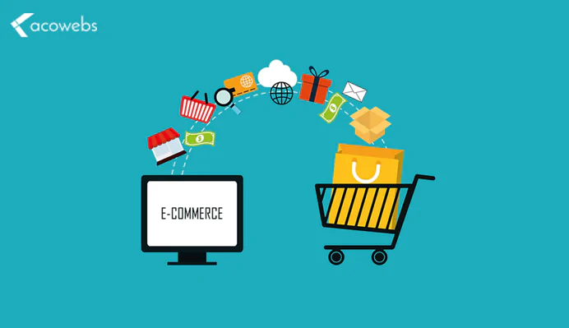
Extensible Markup Language (XML)
Companies use the Internet to generate business transactions and integrate data to increase efficiency and reduce costs. These transactions are known as electronic commerce (e-commerce);
It enables all types of organizations to sell products and services to a global market. E-commerce transactions, the sale of products or services, can take place between businesses (business-to-business, or B2B) or between a business and a consumer (business-to-consumer, or B2C).

Slide 23
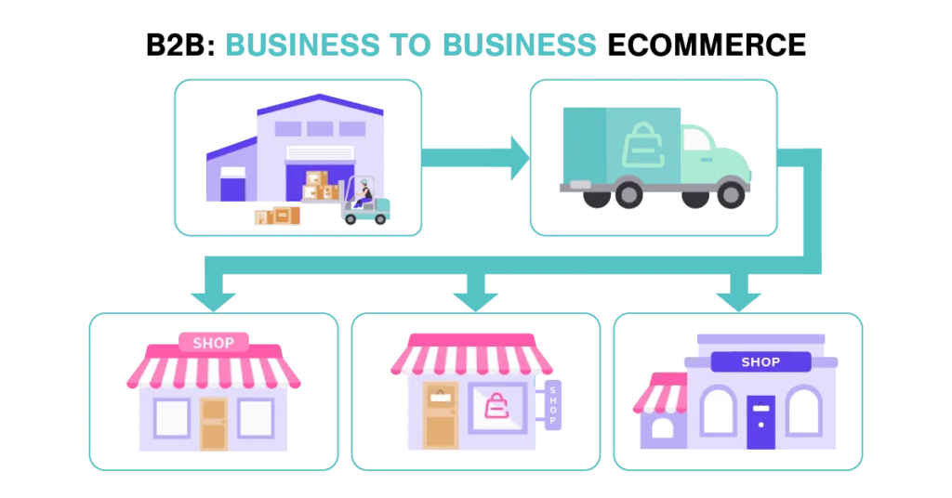
Extensible Markup Language (XML)
Most e-commerce transactions take place between businesses. Because B2B e-commerce integrates business processes among companies, it requires the transfer of business information among different business enti
However, the way in which businesses represent, identify, and use data tends to differ substantially from company to company. As a simple example, some companies use the term product code, while others use item ID.

Slide 24
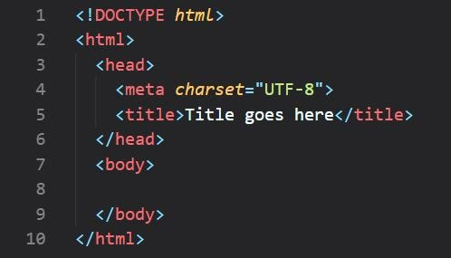
Extensible Markup Language (XML)
Until recently, a purchase order traveling over the web was expected to be in the form of an HTML document.
The HTML webpage displayed on the web browser would include formatting as well as the order details. HTML tags describe how something looks on the webpage, such as typefaces and heading styles, and they often come in pairs to start and end formatting features

Slide 25
Extensible Markup Language (XML)
If an application needs to get the order data from the webpage, there is no easy way to extract details such as the order number, date, customer number, product code, quantity, or price from an HTML document.
The HTML document can only describe how to dis- play the order in a web browser; it does not permit the manipulation of the order’s data elements. To solve that problem, a new markup language known as Extensible Markup Language was developed.

Slide 26
Extensible Markup Language (XML)
Extensible Markup Language (XML) is a meta-language used to represent and manipulate data elements.
XML is designed to facilitate the exchange of structured documents, such as orders and invoices, over the Internet
XML is not a new version or replacement for HTML.
XML is concerned with the description and representation of the data, rather than the way the data is displayed. XML provides the semantics that facilitate the sharing, exchange, and manipulation of structured documents over organizational boundaries.

Slide 27
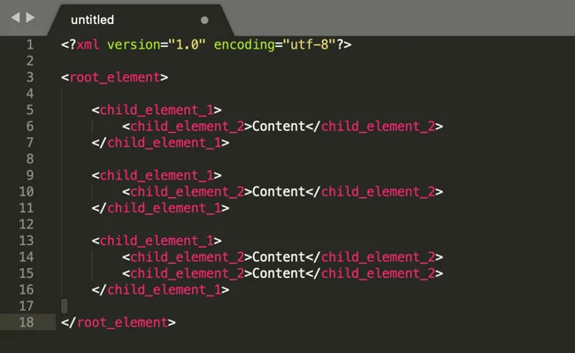
Extensible Markup Language (XML)

Slide 28
DTD and XML Schemas
Companies that use B2B transactions must have a way to understand and validate each other’s tags.
One way to accomplish that task is through the use of document type definitions.
A document type definition (DTD) is a file with a .dtd extension that describes XML elements—in effect, a DTD file provides the composition of the database’s logical model and defines the syntax rules or valid elements for each type of XML document.

Slide 29
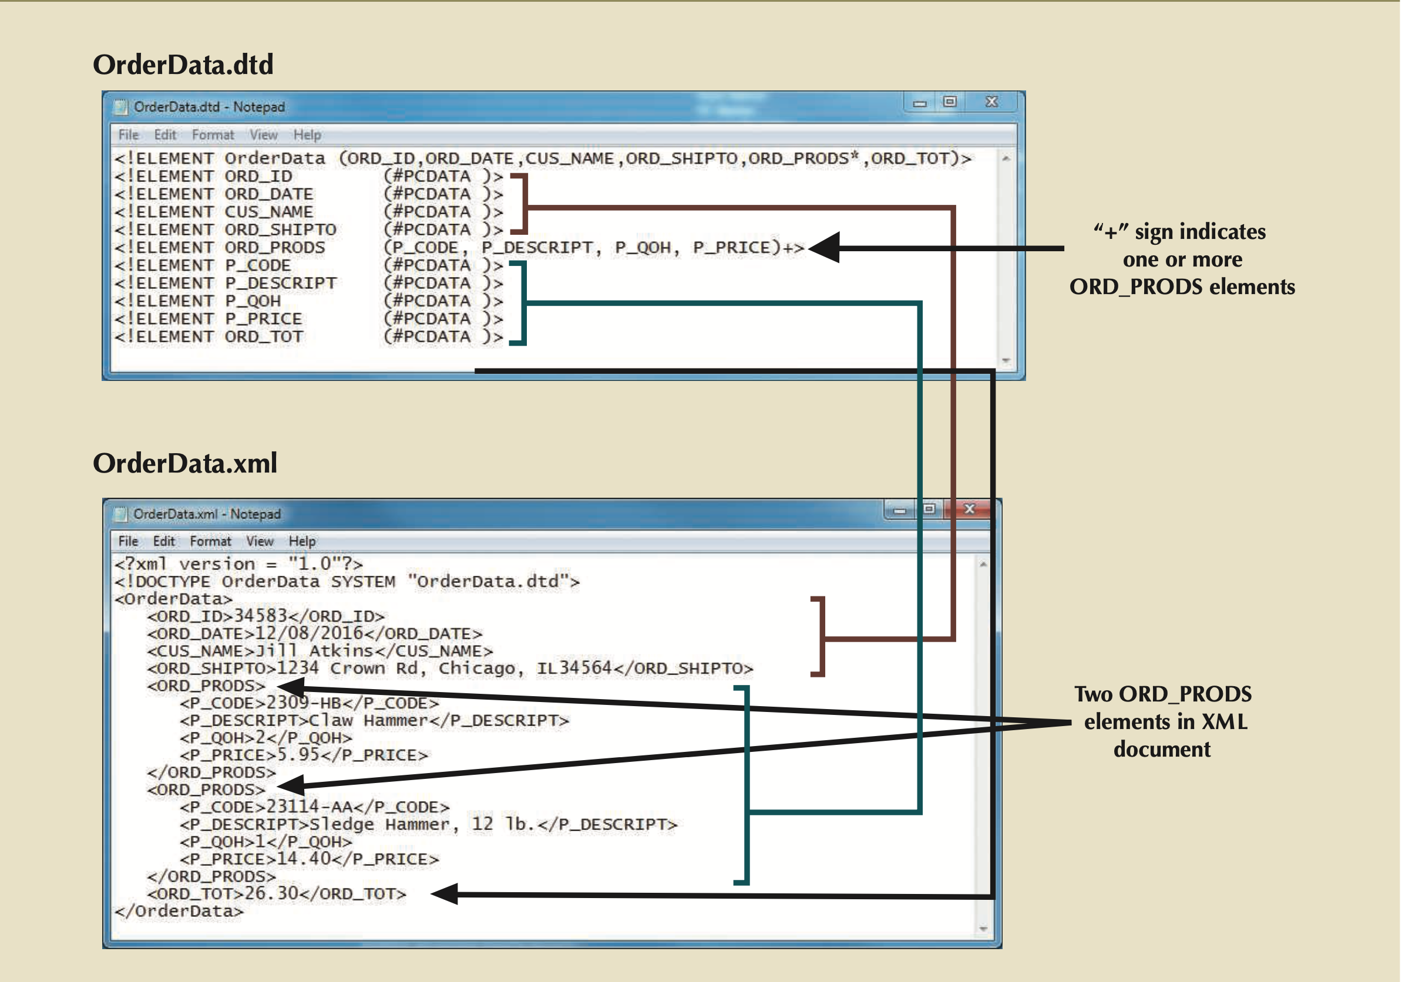
DTD and XML Schemas

Slide 30
Cloud Computing Services
Cloud computing is a computing model for enabling ubiquitous, convenient, on-demand network access to a shared pool of configurable computer resources (e.g., networks, servers, storage, applications and services) that can be rapidly provisioned and released with minimal management effort or service provider interaction.
Cloud services allow any organization to quickly and economically add information technology services such as applications, storage, servers, processing power, databases, and infra- structure to its IT portfolio.

Slide 31
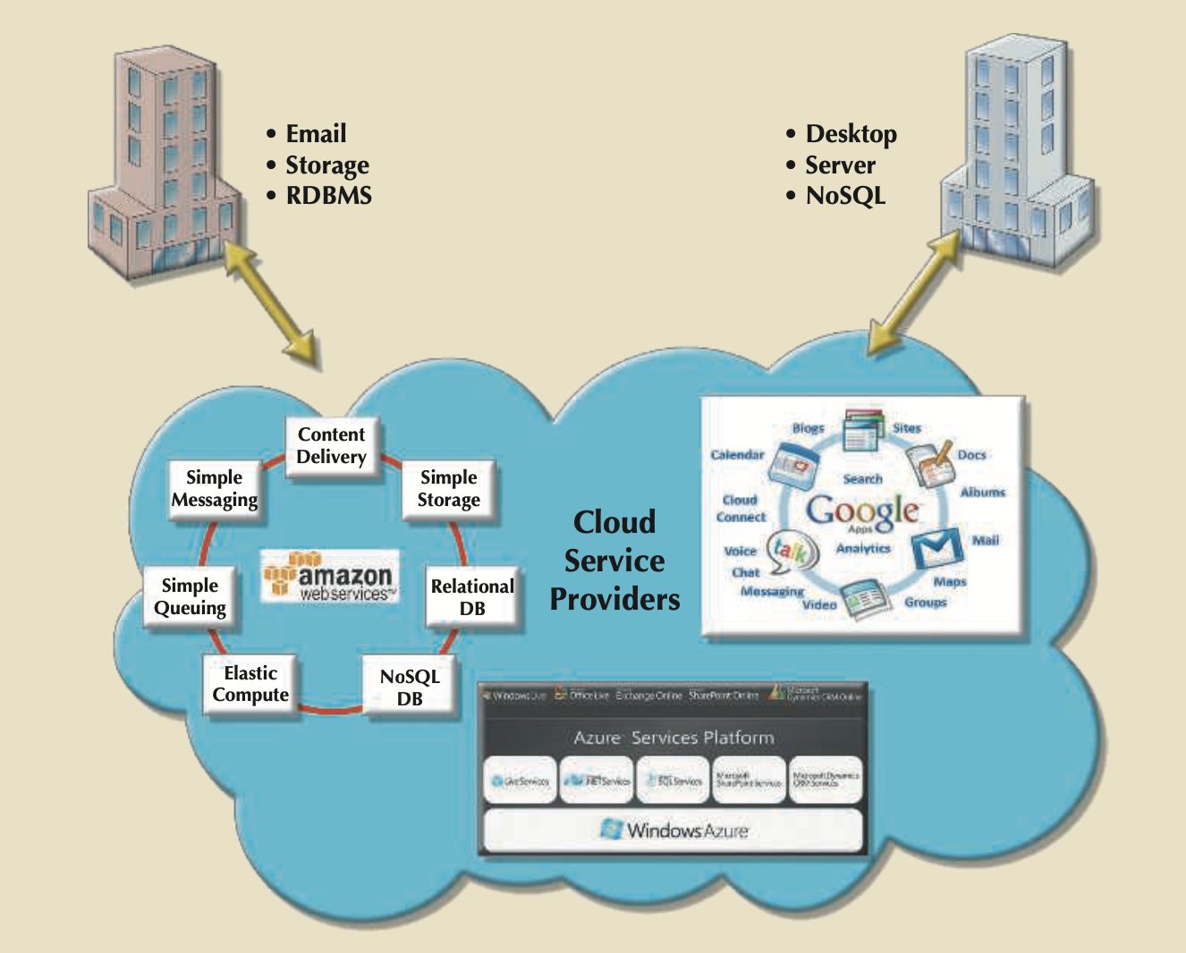
Cloud Computing Services
Cloud computing allows IT-savvy organizations such as Amazon, Google, and Microsoft to build high-performance, fault-tolerant, flexible, and scalable IT services.
These services include applications, storage, servers, processing power, databases, and email,

Slide 32
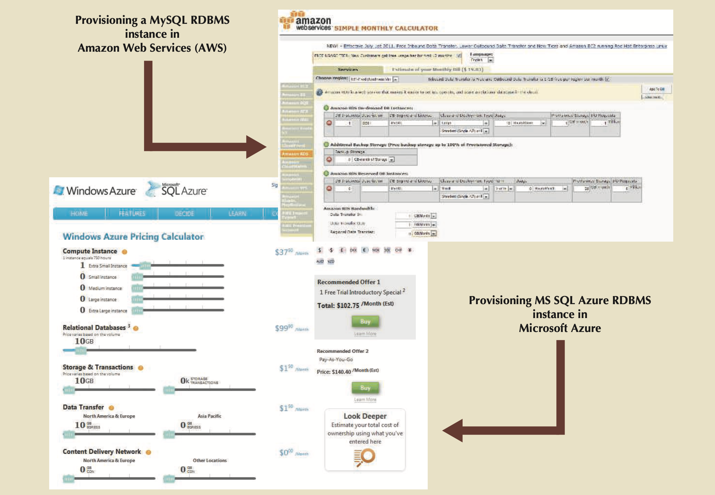

Slide 33
Cloud Computing Implementation Types
Cloud computing has different types of implementations based on who the target cus tomers are:
Public cloud
This type of cloud infrastructure is built by a third-party organization to sell cloud services to the general public.
The public cloud is the most common type of cloud implementation; examples include Amazon Web Services (AWS), Google Application Engine, and Microsoft Azure.
In this model, cloud consumers share resources with other consumers transparently. The public cloud infrastructure is managed exclusively by the third-party provider.

Slide 34
Cloud Computing Implementation Types
Private cloud
This type of internal cloud is built by an organization for the sole pur- pose of servicing its own needs. Private clouds are often used by large, geographically dispersed organizations to add agility and flexibility to internal IT services. The cloud infrastructure could be managed by internal IT staff or an external third party.
Community cloud
This type of cloud is built by and for a specific group of organizations that share a common trade, such as agencies of the federal government, the military, or higher education. The cloud infrastructure could be managed by internal IT staff or an external third party.

Slide 35
Characteristics of Cloud Services
Ubiquitous access via Internet technologies. All cloud services use Internet and web technologies to provision, deliver, and manage the services they provide. The basic requirement is that the device has access to the Internet.
Shared infrastructure. The cloud service infrastructure is shared by multiple users. Sharing is made possible by web and virtualization technologies. Cloud services effectively provide an organization with a virtual IT infrastructure, which is locally managed by the consumer’s organization as if it were the only user of the infrastructure.
Lower costs and variable pricing. The initial costs of using cloud services tend to be sig- nificantly lower than building on-premise IT infrastructures.

Slide 36
Characteristics of Cloud Services
Flexible and scalable services. The cloud services are built on an infrastructure that is highly scalable, fault tolerant, and very reliable. The services can scale up and down on demand according to resource demands.
Dynamic provisioning. The consumer can quickly provision any needed resources, including servers, processing power, storage, and email, by accessing the web man- agement dashboard and then adding and removing services on demand. This process also could be automated via other services.
Service orientation. Cloud computing focuses on providing consumers with specific, well-defined services that use well-known interfaces. These interfaces hide the complexity from the end user, and can be delivered anytime and anywhere.

Slide 37
Characteristics of Cloud Services
Managed operations. Cloud computing minimizes the need for extensive and expensive in-house IT staff. The system infrastructure is managed by the cloud provider.
The consumer organization’s IT staff is free from routine management and maintenance tasks so they can focus on other tasks within the organization. Managed operations apply to organizations that use public clouds and that outsource cloud management to an external third party.

Slide 38
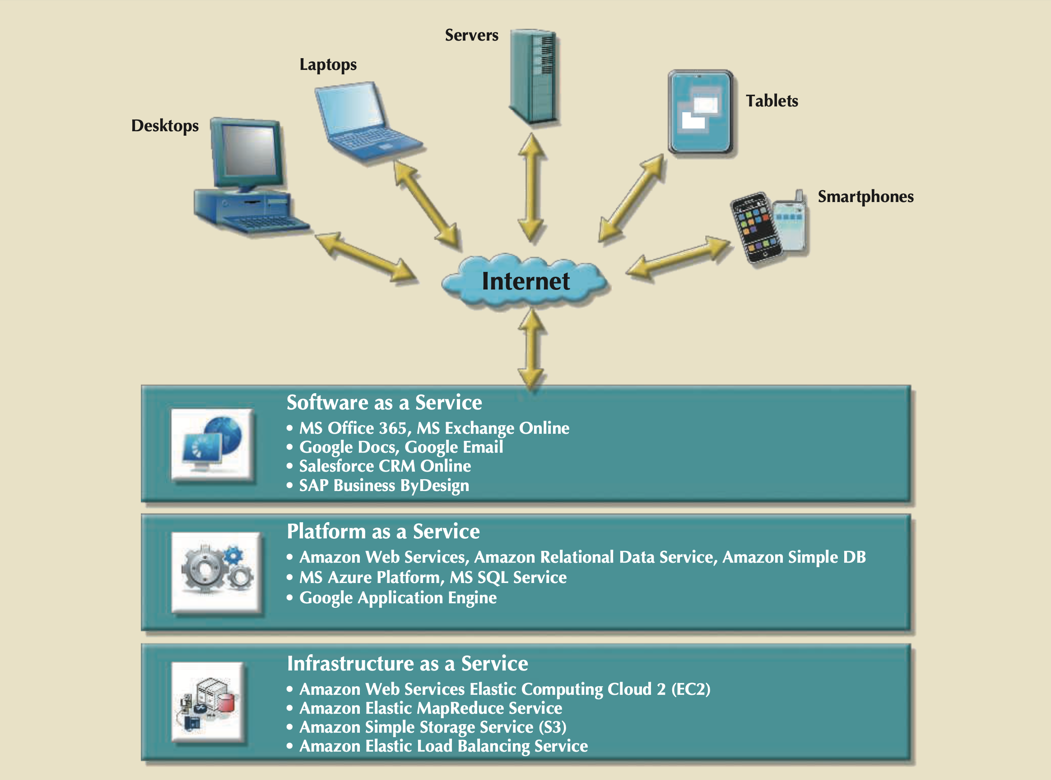
Types of Cloud Services

